Slide 1
Welcome Message
Large Generative Models Meet Multimodal Applications (LGM3A’25)
Zheng Wang, Huawei
Notes:
Hello everyone, welcome our workshop, large generative models meet multimodal applications. I am Wang Zheng from Huawei Singapore

Slide 2
Introduction of LGM3A Workshop
Background
Workshop explores LLMs for multimodal interaction
Growing need to use LLMs with increasing multimodal data
Workshop welcomes professionals to explore multimodal model trends and practices
Scope and Topics:
A platform to present latest works
Foster discussions on current challenges and opportunities
Identify emerging trends in Multimodal Large Language Models
Potential impact on future research and development
Notes:
I first introduce our workshop, this workshop explores LLMs for multimodal interaction, highlighting the growing need to use LLMs with increasing multimodal data, and welcomes professionals to explore emerging multimodal model trends and practices. For scope and topics, our workshop is a platform to present latest works, foster discussions on current challenges and opportunities, identify emerging trends in Multimodal Large Language Models, and explore their potential impact on future research and development.

Slide 3
Acknowledgments
Workshop Organization
Workshop Statistics:
4 invited keynotes + 4 accepted papers
Acceptance rate: ~57%
Zheng Wang (Huawei Singapore Research Center, Singapore)
Qianqian Chen (Huawei Singapore Research Center, Singapore)
Yiyang Luo (Huawei Singapore Research Center, Singapore)
Zhiqiu Ye (Huawei Singapore Research Center, Singapore)
Yangkai Ding (Huawei Singapore Research Center, Singapore)
Hanwang Zhang (Nanyang Technological University, Singapore)
Tat-Seng Chua (National University of Singapore, Singapore)
Notes:
Our organizers are from Huawei Singapore, Nanyang Technological University, and National University of Singapore. In this year workshop, we have four invited keynotes and four accepted papers, our acceptance rate is around 57%

Slide 4
Schedule
Time (Dublin) | Session
13:30 – 13:40 | Welcome Message from the Chairs
13:40 – 14:20 | Keynote 1 — From Multimodal Generative Models to Dynamic World Modeling (Ziwei Liu)
14:20 – 15:00 | Keynote 2 — Video Intelligence in the Era of Multimodal (Mike Zheng Shou)
15:00 – 15:40 | Keynote 3 — Recent Advances in 3D Generation: From 3D Assets to CAD Models (Guosheng Lin)
15:40 – 16:20 | Keynote 4 — On Path to Multimodal Generalist: General-Level and General-Bench (Hao Fei)
16:20 – 16:30 | Paper Presentation 1 — Annotation-Free Prompt Expansion for Chinese Text-to-Image Generation
16:30 – 16:40 | Paper Presentation 2 — Enabling Dynamic Storytelling via Training-Free Multimodal Synchronized Video Synthesis with Character Consistency
16:40 – 17:00 | Closing & Networking
Notes:
This is the schedule of today’s workshop, we have four keynote talks following two paper presentation, the last part is networking.

Slide 5
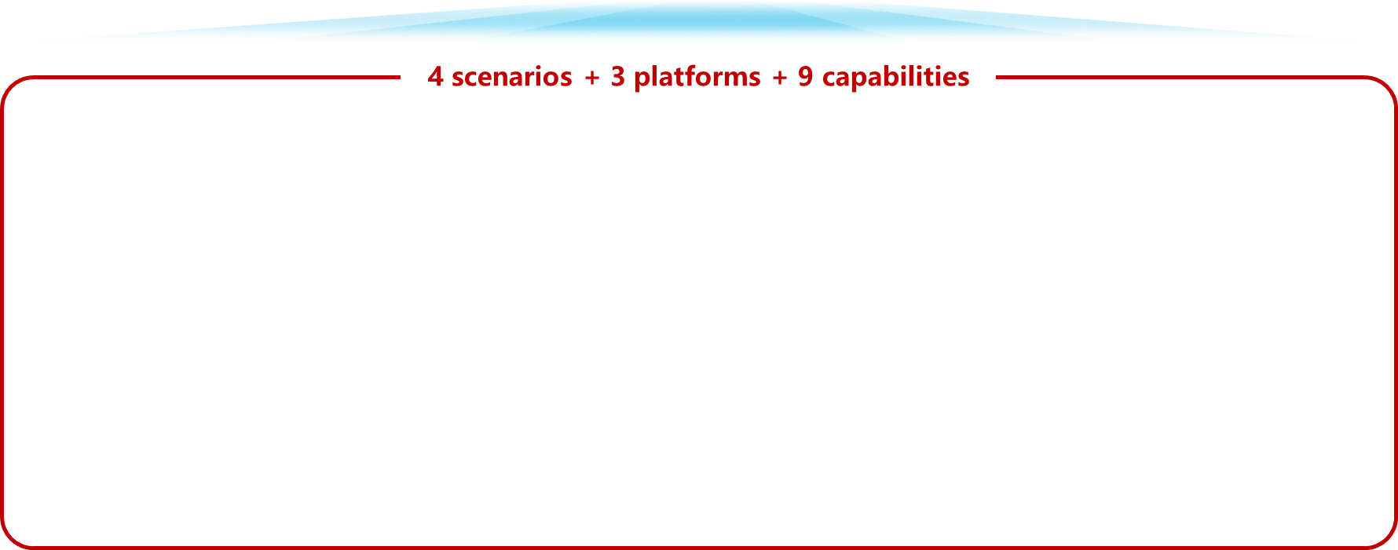
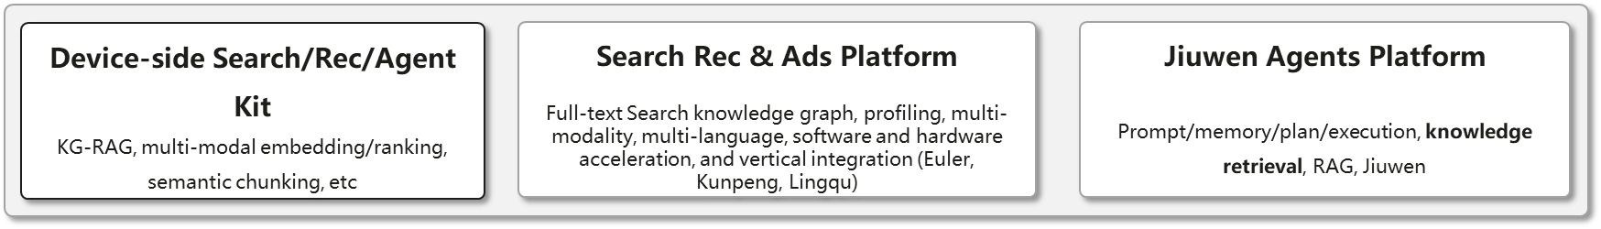
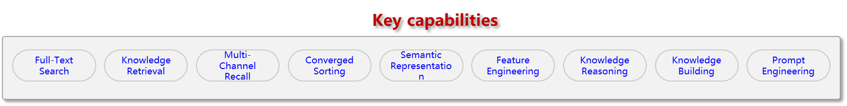
2012 Labs – Central Software Institute - Poisson Lab Overview
Notes:
Next, I’d like to give a brief introduction of our Huawei Lab, called Poisson Lab. It is part of the Central Software Institute under 2012 Labs. The scope of our lab includes 4 scenarios, 3 platforms, and 9 capabilities. Specifically, We support the scenarios of Device-Side Search and Recommendation such as HarmonyOS, AI Search such as conversational search, advertisment search and recommendation such as News Feeds, and LLM application development and execution similar to Coze platform. For platforms, we build 3 platforms including Device-side Search/Recommendation/Agent Kit, search recommendation and advertisement platform, and Jiuwen agents platform. To support these platforms, we require key capabilities including full-text search, knowledge retrieval, multi-channel recall, converged sorting, semantic representation, feature engineering, knowledge reasoning, knowledge building, and prompt engineering.
Our platforms support applications for customers such as Celia Knowledge Q&A, and business including Huawei Cloud and MetaERP.

Slide 6





Our Research Outcome on JiuWen Agent Platform (九问)
Current Research: Next-Gen AI Agent Application Platform
Retrieval-Augmented Generation (RAG)
M-RAG: RAG on Multiple Partitions
EMG-RAG: Crafting Personalized Agents with RAG
Multimodal Applications
MMQS: Multimodal Query Suggestion
ColPro: Continual Learning in Video QA
TrajSV: Multimodal Video Representation Learning
Self-Evolving Agent Planning
InstructRAG: RAG for LLM-based Agent Planning
MASTER: Multi-Agent with MCTS
To Business
To Customer
To Government
To Developer
Application Development Platform
AI Agent
A framework for developing LLM applications
RAG
Orchestration Engine
Multimodal
Prompt Engine
Planning
Engine
Execution Engine
Vector Database
Plug-in Management
Memory
Management
Offline Data Processing
LLMs
AI Computing Resources
[1] Zheng Wang, Shu Xian Teo, Jieer Ouyang et al. Reinforcing Large Language Model Performance through Retrieval-Augmented Generation with Multiple Partitions. ACL 2024
[2] Zheng Wang, Zhongyang Li, Zeren Jiang, Dandan Tu, Wei Shi. Crafting Personalized Agents through Retrieval-Augmented Generation on Editable Memory Graphs. EMNLP 2024
[3] Zheng Wang, Bingzheng Gan, Wei Shi. Multimodal Query Suggestion with Multi-Agent Reinforcement Learning from Human Feedback. WWW 2024
[4] Chen Cai*, Zheng Wang*, Jianjun Gao et al. Empowering Large Language Model for Continual Video Question Answering with Collaborative Prompting. EMNLP 2024
[5] Zheng Wang, Shu Xian Teo, Wei Shi. InstructRAG: Leveraging Retrieval-Augmented Generation on Instruction Graphs for LLM-Based Task Planning. SIGIR 2025
[6] Bingzheng Gan. Yufan Zhao, Tianyi Zhang, Jing Huang et al. MASTER: A Multi-Agent System with LLM Specialized MCTS. NAACL 2025
[7] Zheng Wang*, Shihao Xu*, Wei Shi.TrajSV: A Trajectory based Pre-trained Model for Sports Video Representations and Applications. TCSVT 2025
Notes:
I introduce a real industry application development platform, which is built based on a pre-trained LLM, we incorporate other modules such as RAG, vector database, multimodality, and planning engine, to create AI agents for a range of applications, including the applications to customers (XiaoYi smartphone AI assistant, and search engines), and to business (ERP systems). My research contributes to the platform in terms of the RAG, multimodal applications, and LLM-based task planning. I introduce the overview of these research and remove technical details given this is a 15-minute presentation.
For RAG, we propose M-RAG, which treats database partitions as basic units for RAG rather than a whole database as existing studies. We also propose a multi-agent framework that optimizes end-to-end metrics instead of retrieval accuracy. We also study EMG-RAG. The background is to build LLM-based personalized AI Assistant. In smartphone AI Assistant (for example Siri in IPhone or Xiaoyi in Huawei), we can collect data from everyday conversations, or screenshot contents by OCR between users and the AI Assistant. We manage the data called memories, and use the memories for many downstream applications, including question answering, autofill forms, and slot filling through RAG.
For Multimodal Application, We propose Multimodal Query Suggestion, Query suggestion is a fundamental problem for search engine. We propose a new paradigm called multimodal query suggestion, which accepts a query image, and outputs some textual suggestions. We capture Intentionality and diversity in MMQS. We also explore a fine-tuning technique called collaborative prompting to address VideoQA, which is to answer new questions in a continual learning setup.
In addition, We study LLM-based task planning, where we study agentic retrieval, which is retrieval instructions to guide agent planning.
For future research, I want to explore personal LLM Agents within the framework, where I identify important scenarios and techniques in personal LLM Agents. One is streaming RAG, which is to handle frequent stream data on personal devices. For example, we send messages to Xiaoyi one-by-one every minute, where the messages are the stream data. The other one is regarding Generation-Augmented Multimodal Retrieval, where we want to align retrieval capability in personalized AI assistant with user preferences using LLMs.

Slide 7
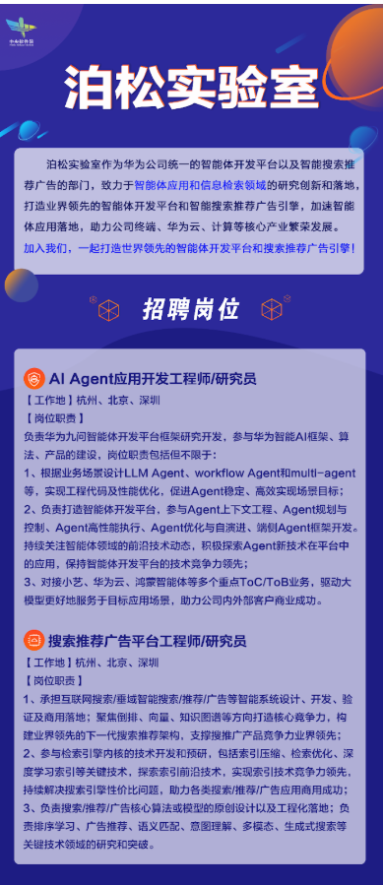
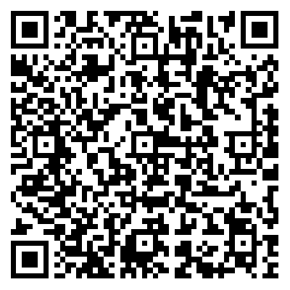
Innovate with Us
• What We Do
> Multimodal AI for search, recommendation, and content generation
> Knowledge graph & temporal-spatial reasoning for next-gen intelligence
> LLM-driven creative automation and workflow generation
• We are Looking For
> AI Agent Engineer / Researcher
> Search & Recommendation Software Engineer (Search/Recommendation/Ads Engine)
> Search & Recommendation Algorithm Engineer / Researcher (Search/Recommendation/Ads)
• Why Join Us
> Cutting-edge multimodal AI and large-model applications
> Real-world industrial impact and innovation
> Collaborative, international research environment
• Application Link
career.huawei.com/reccampportal/portal5/campus-recruitment-detail.html?jobId=24233&dataSource=1&jobType=2&recruitType=CR&sourceType=001
Notes:
Finally, this is a recruitment information, we are looking for AI agent Engineer/Researcher, Search&Recommendation Software Engineer and Researcher. This is the application link, everyone can scan this QR code to submit your CV.

