Slide 1
Effective and Efficient Sports Play Retrieval with Deep Representation Learning
Zheng Wang¹, Cheng Long¹, Gao Cong¹, Ce Ju²
¹Nanyang Technological University
²Intelligent Driving Group, Baidu Inc.

Slide 2
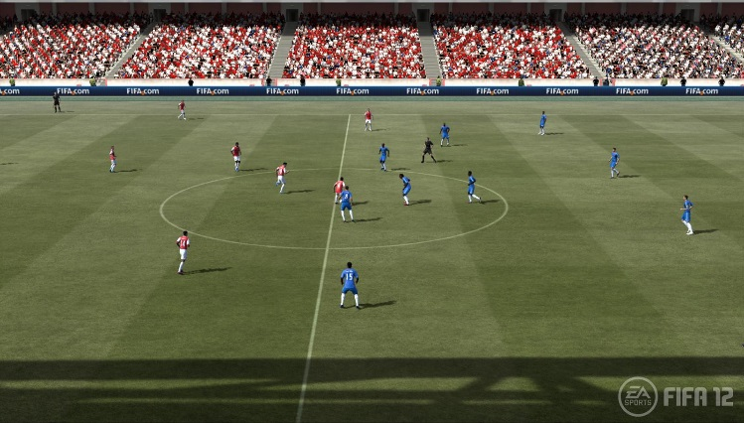
Sports Data
Visual sports data:
Widely used and accessed
Does not support quantitative analytics well
How far has Messi run during a game?
Spatiotemporal sports data:
New perspectives for sports analytics
Quantitative analytics
Sources: https://gregmedia.wordpress.com/games-design/
Notes:
Traditionally, sports are usually captured visually as videos. We call this type of sports data the visual sports data.
The visual sports data, or the sports videos, are widely used and accessed, e.g., a professional sports game would be recorded by cameras and the generated video would be made accessible to a broad range of users.
One issue with visual sports data is that it does not support quantitative analytics well, e.g., based on a video of a FC Barcelona’s game, it is difficult to know how far Messi has run.
Nowadays, with the advance of optical systems and also positioning systems, people have started to capture a sports game by tracking the locations of the players and also the ball at high frequency. Here is a demo on the data that is collected in this case. In this frame, each blue dot represents a player from one team and each red one represents one from the other team and the white represents a ball.
We call this type of sports data the spatiotemporal sports data since it essentially corresponds to a set of multiple of trajectories of the players and also the ball. This new type of sports data provides quite a few new perspectives for sports analytics and has been used for various types of sports analytics

Slide 3
Spatiotemporal Sports Data Analytics
Player performance
analytics
Auto role detection
Similar plays retrieval
Tactics analytics
…
Notes:
Some examples of different types of spatiotemporal sports data analytics;
We focus on similar plays retrieval.

Slide 4
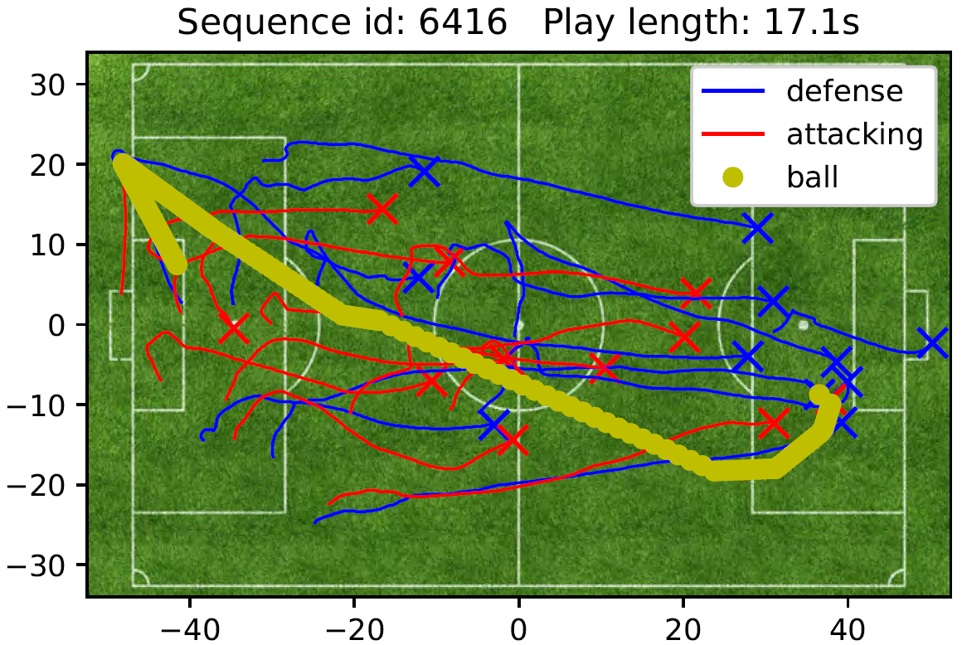
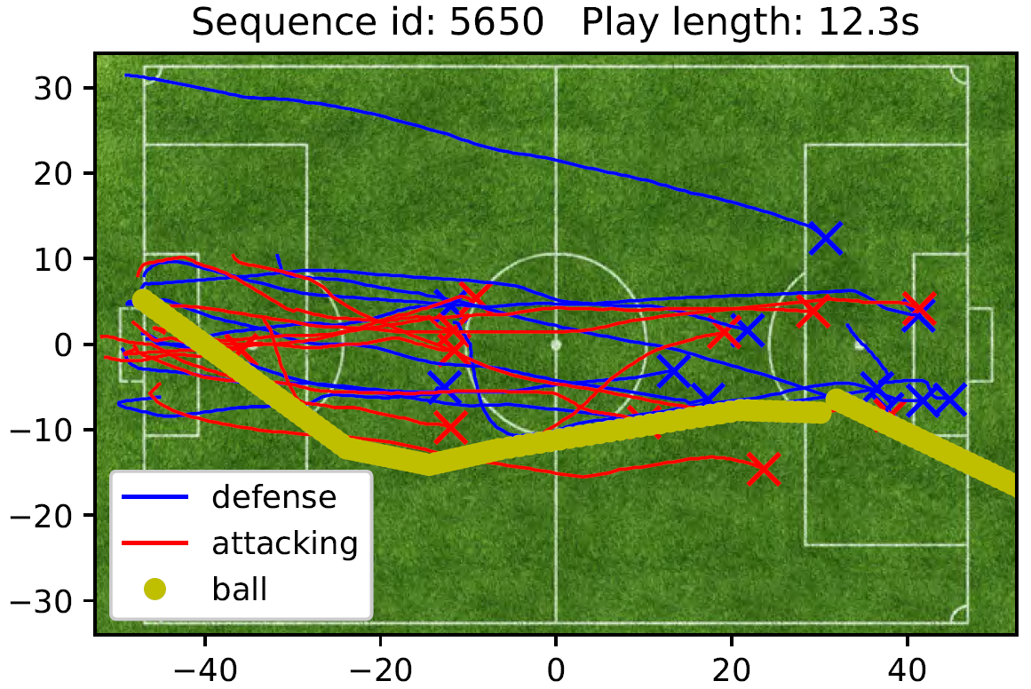
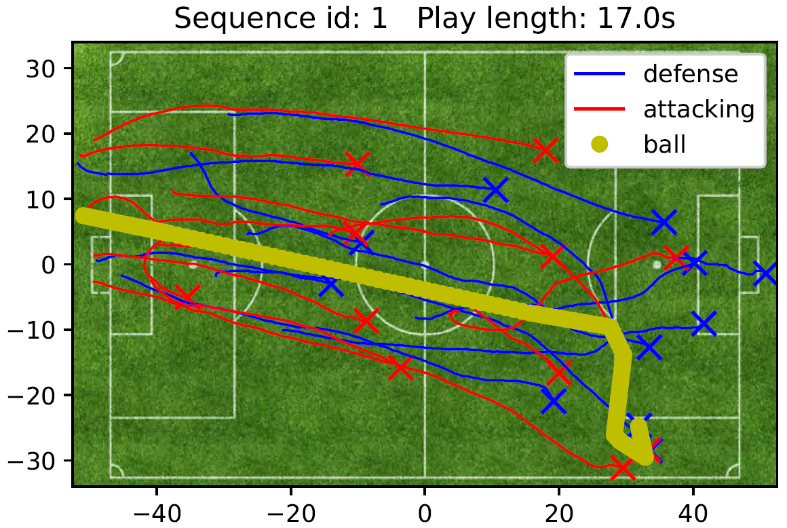
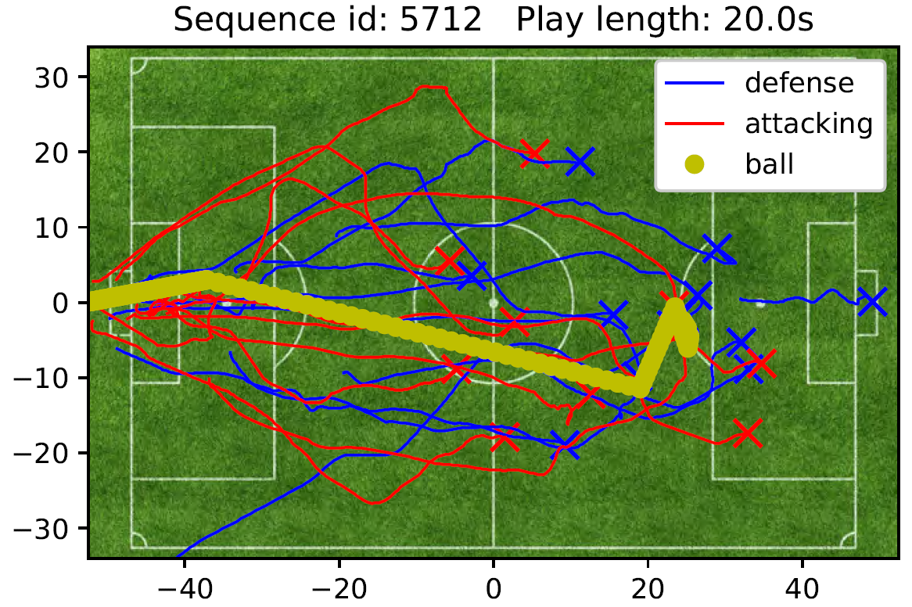
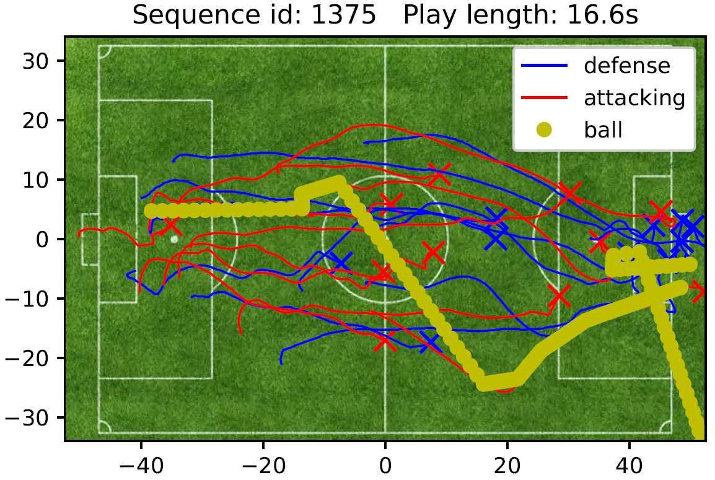
Similar Plays Retrieval
Play 1
Similar Play Retrieval:
Find k plays that are the most similar to the query play
Play 2
… …
… …
Key operator:
Measure the similarity between two plays
Query play
Play N-1
Play N
Notes:
Suppose we have N plays in the database.
Now, given a query play, the similar play retrieval problem is to find k plays from the database, which are the most similar to the query play.
A key operator here is to measure the similarity between two plays since if we know how to measure the similarity between two plays, a simple solution for this problem is then to scan the database, measure the similarity between each play and the query one and then return k plays that are the most similar to the query play.

Slide 5
Existing Play Similarity Measurements (1) – Matching-based Alignment Approach
Similarities between trajectories
Efficiency Issue:
Quadratic for computing the weight of each edge
Cubic for computing an optimal alignment
Attacking team
…
…
Defending team
…
…
Ball
Notes:
Here we review the existing approaches for measuring the similarity between two plays, which are mostly alignment-based approaches;
The main idea is as follows. Given two plays, it first retrieves for each team the trajectories of attacking players, those of defending players, and that of a ball. It then constructs a bipartite graph between sets of trajectories like this. Each edge would be associated with a weight that is equal to the similarity between two trajectories based on existing methods such as DTW. Finally, it computes maximum weight matching on each bipartite graph and aggregate the weights of the matches as the similarity between the two plays.
While this approach reduces the problem of measuring the similarity between two plays to one between trajectories, it suffers from a few issues and a major one is of efficiency. For example, it costs quadratic time for computing the weight of each edge and cubic time for computing the maximum weight matching on each bipartite graph.

Slide 6
Existing Play Similarity Measurements (2) – Role-based Alignment Approach
Efficiency Issue:
Quadratic for computing the weight of each edge
Right wing
…
…
Effectiveness Issue:
Assumptions not justified
Center
Left back
…
…
Right back
Robustness Issue:
No mechanisms for handling noises
Ball
Notes:
To reduce the time cost of the matching-based alignment strategy, a role-based alignment approach has been proposed.
Same as the matching-based alignment method, this approach reduces the problem to one of measuring the similarities between trajectories, and the difference is that it first detects the roles of each trajectory, for example, in the context of soccer data, roles could be right wing, center, left back, and so on, and then it aligns those trajectories with the same role to each other; and as a consequence, the matching step which costs cubic time is saved. Finally, it aggregates the similarities between the trajectories that have been aligned to each other as one between the two plays.
Nevertheless, this approach still runs in at least quadratic time for computing the similarities between trajectories. Besides, all alignment-based approaches rely on some assumptions that are not justified, for example, these approaches assumes that each pair of trajectories that are aligned to each other contributes equally to the similariity between the two plays. Another issue is that these approach have no mechanisms for handling noises while it is widely known that the trajectories collected by sensors intrinsically contain nosies.

Slide 7
New Play Similarity Measurement – A Representation Learning Approach (play2vec)
Efficiency advantage:
Linear time complexity
Representation learning
(play2vec)
Effectiveness advantage:
Data-driven
Robustness advantage:
De-noising mechanism
R^{d}
Euclidean distance
Notes:
We proposed a new play similarity measurement based on representation learning, and we call it play2vec.
Here, we give an overview of this method with details introduced later on.
Given two plays, we perform representation learning on them and then obtain their corresponding representations as d-dimensional vectors such that the similarity between two plays is captured by the Euclidean distance between their corresponding vectors. We then compute the Euclidean distance between the two vectors and return it as the similarity, which is efficient.
Compared with the existing alignment-based approaches, this representation learning approach enjoys a few advantages. First, it runs in linear time and thus it is efficient; Second, it is a data-driven approach and thus it avoids those human-made assumptions. Third, as will be explained later, it incorporates mechanisms for handling noises and thus it is robust to the data noises.

Slide 8
Similar Plays Retrieval based on Representation Learning (play2vec)
Representation learning
(play2vec)
Representation learning
(play2vec)
Play 1
R^{d}
Play 2
… …
… …
Query play
Play N-1
Play N
K Nearest Neighbor
Notes:
Based on the representation learning approach for measuring the similarity between two plays, we could do the similar plays retrieval process as follows.
Suppose these are plays in the databases. We perform representation learning on each of these plays and obtain a vector in a d-dimensional space.
Now, a similar play query comes, where we have a query play. Again, we learning its vector representation and then compute the its k nearest neighbors in the vector space and return the corresponding plays as the top-k similar plays.
All sounds good, correct? But wait, we have no idea about the representation learning step yet. Next, I shall introduce how wo do this step.

Slide 9
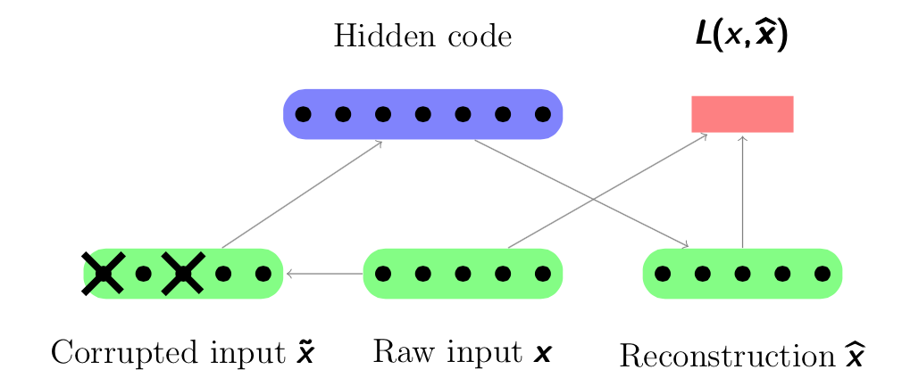
Denoising Autoencoder Structure
Representation
Sources: http://psyyz10.github.io/2015/11/SDA/
Notes:
Just before I start, I give a bit background of the denoising autoencoder structure which would be used in our play2vec component.
This is an overview of the structure. And the basic idea is as follows.
Suppose we have some raw input x as a sequence. We corrupt it by injecting some noise and get a corrupted version x tilde. Then, we learn extract some hidden code from x tilde, say, by using a RNN network, and further to re-construct another sequence x hat from the hidden code, say, by using a RNN network network. We measure the loss as the difference between x and x hat for training the structure. Finally, we take this hidden code, which is in the form of a vector as the representation of data x.
In summary, the intuition of denoising autoencoder is to learn a representation by extracting features from a corrupted version of some data as a vector and then reconstructing the original data based on the extracted features, which is a very typical unsupervised learning approach.

Slide 10
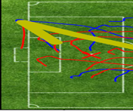
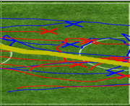
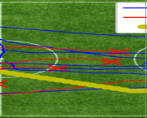
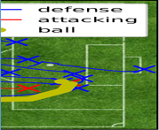
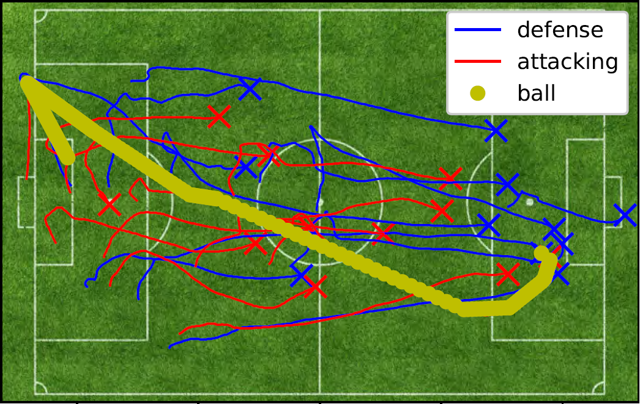
Representation Learning (play2vec)
Target representation
Prediction
Encoder
Encoder
LSTM
LSTM
LSTM
LSTM
LSTM
LSTM
LSTM
LSTM
Loss
Embedding
Embedding
Corrupted play segments
Raw play segments
Raw play
Notes:
Now we are ready to introduce our representation learning approach, play2vec, in detail.
Given a raw pay, we first split it into a sequence of play segments with equal durations.
We then inject noises to the play segments and get the corrupted play segments.
We then embed both the raw play segments and the corrupted play segments into vectors.
We then feed the vectors based on corrupted play segments to a RNN network called encoder, which consists of LSTMs, and obtain a hidden vector.
We then feed this hidden vector and also the vectors based on raw play segments to another RNN network called decoder, which consists of LSTMs, and obtain a series of vectors as outputs. We further feed each of the vectors to a prediction model which is a fully connected network to predict a play segment token and then measure the loss based on the difference between the predicted tokens and the tokens obtained in the embedding step.
Once this is trained, we take the hidden vector outputted by the encoder as the vector representation of the raw play. As it could be noticed, this is exactly a denoising autoencoder structure as reviewed before.
Next, I will briefly how the embedding component works.

Slide 11
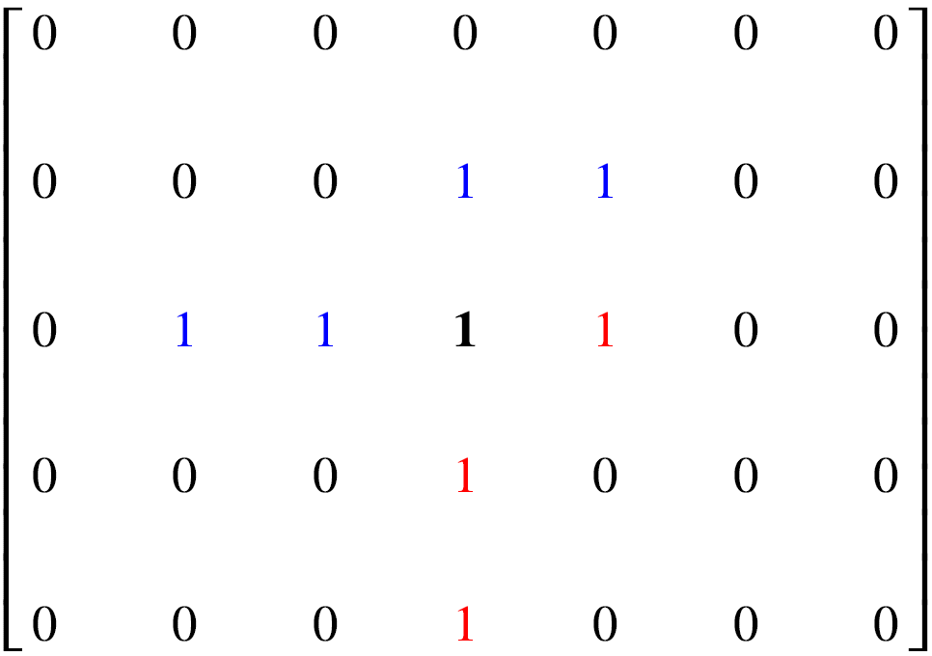
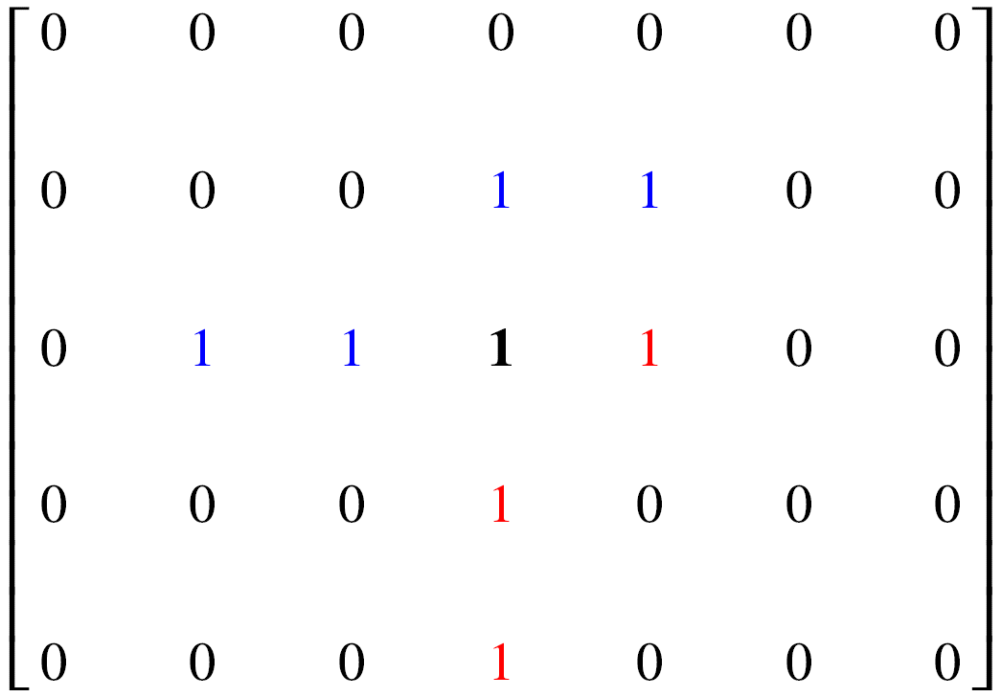
Representation Learning (play2vec)
Embedding
word2vec
Play segments
Embedding
Segment tokens
Clustering
Segment matrices
Mapping
Play segments
Notes:
The input of the embedding component is a sequence of play segments, either the raw ones or the corrupted ones, which constituting a play;
We first map each of the play segment to a binary matrix by using a grid, where an entry of the matrix is set to 1 if its corresponding cell is traversed through by the trajectories of the play segment and 0 otherwise; For illustration, consider play segment with two trajectories only. We use a grid as indicated by the black lines here. Then, we obtain a matrix like this, where a blue one means that the corresponding cell is traversed through by the blue trajectory, a red one by the red trajectory and a black one by both;
Then, we do a clustering process to group similar matrices into the same cluster and assign them a common token.
Finally, we do a word2vec process to embed each token to a vector, which finishes the embedding process.

Slide 12
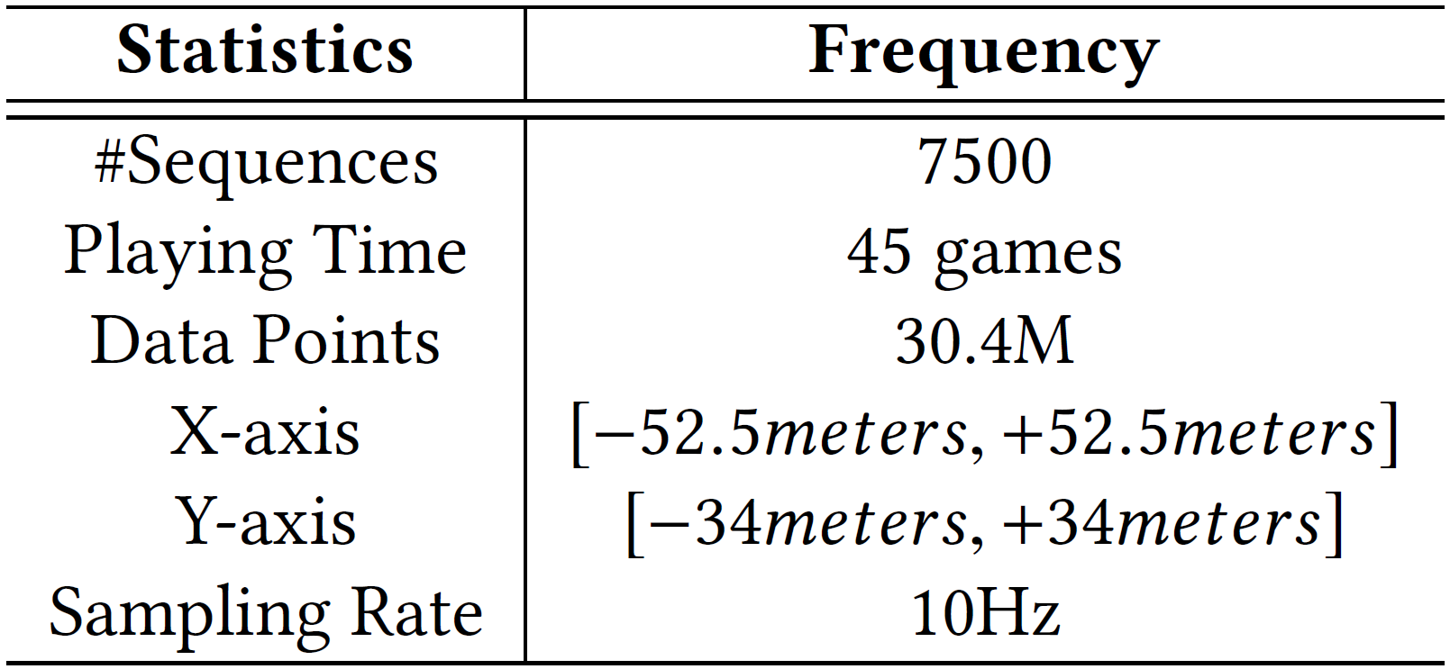
Experiment Set-up
Algorithms
DTW
Frechet
Chalkboard
EMDT
play2vec
Experiments | Performance metrics
Effectiveness | Self-similarity
 | Cross-similarity
 | kNN-similarity
Efficiency | Running time
Usability | Case studies
Notes:
That’s roughly all the technical part.
We used real soccer data from STATSLLC, which consists of about 7,500 plays, with the duration worthing about 45 games. In total, there are about 30million of sampled positions.
We evaluated 5 algorithm including ours play2vec.
We studied three aspects of the algorithms, namely the effectiveness, the efficiency, and the usability.

Slide 13
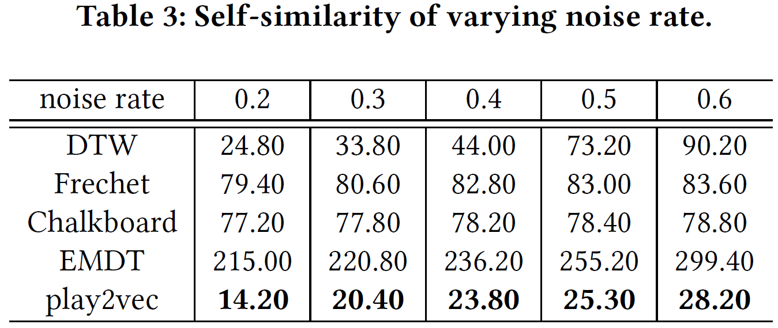
Effectiveness Experiment Results (1) – Self-similarity
Notes:
Here is first set of Effectiveness experiment results, measured by self-similarity.
Given a query play, the self-similarity measure means the similarity rank of a corrupted version of itself. Therefore, the lower it is, the better the algorithm is.

Slide 14
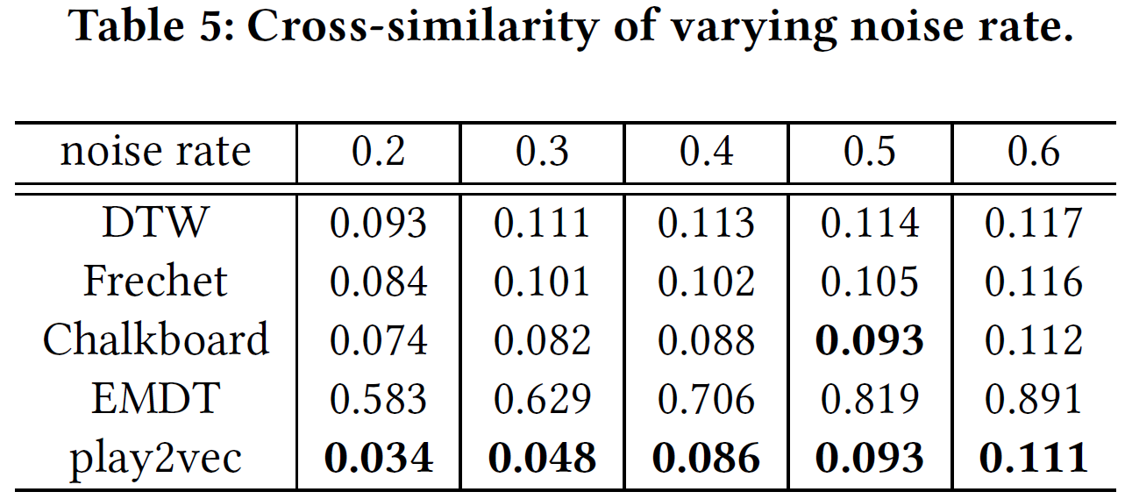
Effectiveness Experiment Results (2) – Cross-similarity
Notes:
Here is second set of Effectiveness experiment results, measured by cross-similarity.
Given two plays, the cross-similarity measure means the deviation of the similarity between their corrupted versions from that between their original versions. Therefore, the lower it is, the better the algorithm is.

Slide 15
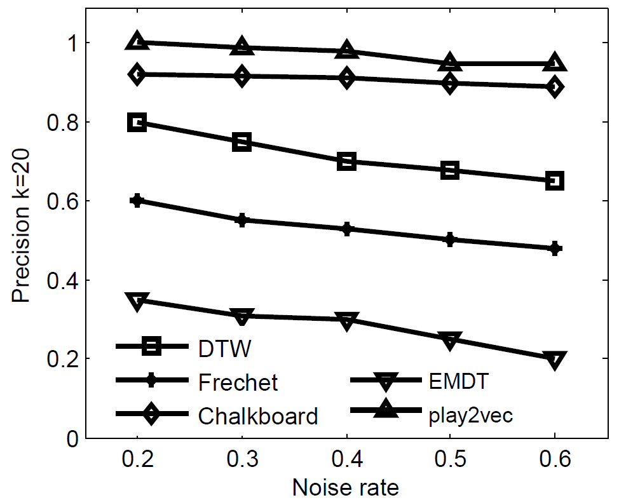
Effectiveness Experiment Results (3) – kNN-similarity
Notes:
Here is third set of Effectiveness experiment results, measured by kNN-similarity.
Given a query play, the kNN-similarity measure means the percentage of its top-k similar plays from the corrupted database that are true top-k similar plays from the original database. Therefore, the higher the result is, the better the algorithm is.

Slide 16
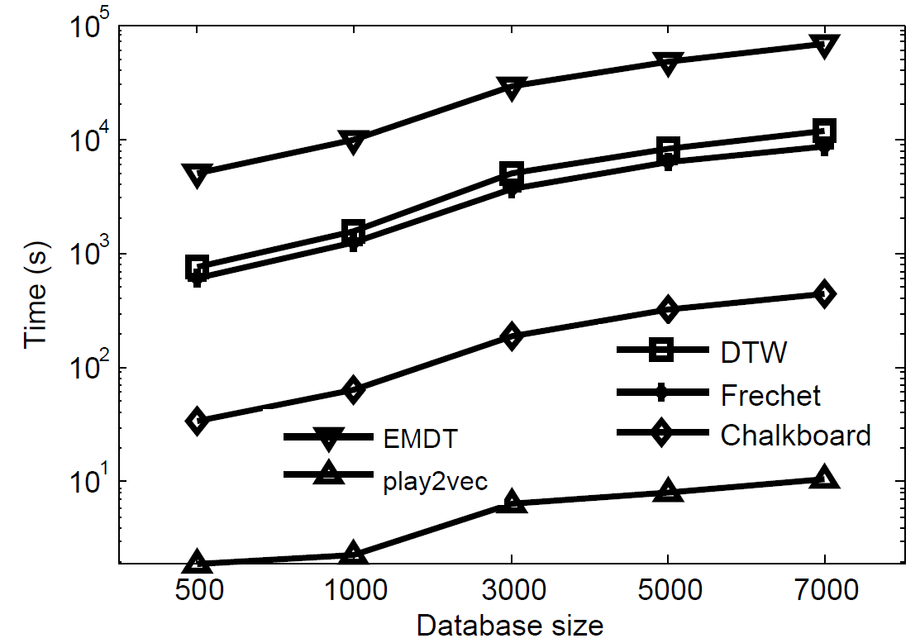
Efficiency Experiment Results – Running Time
Notes:
Here are the efficiency experiment results. As could be noticed, the play2vec based method runs significantly faster than others.

Slide 17
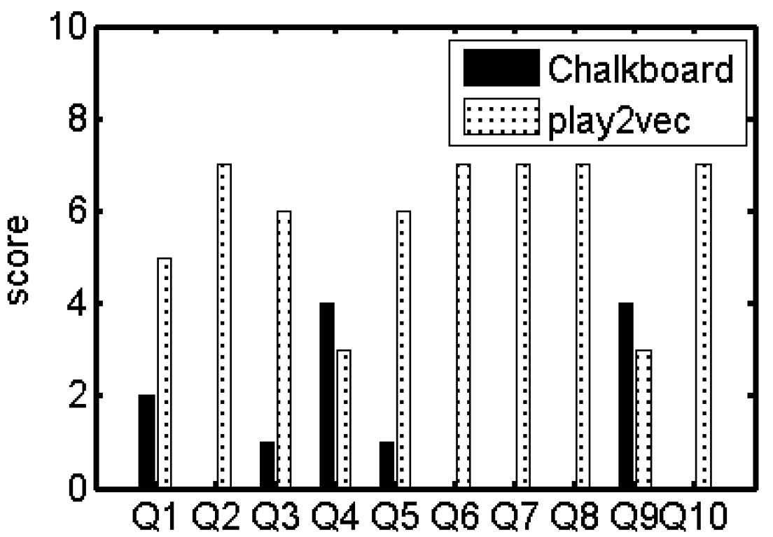
Usability Experiment Results – Case Studies
17.14%
82.86%
Notes:
In the user study, we recruited a group of 7 volunteers with strong soccer background, presented them for each of 10 queries, the top-1 returned by paly2vec and also the top-1 returned by Chaldboard, and then asked them choose one that they think is more similar to the query play.
Here are the results, where we can see in most cases, the plays returned by play2vec look more similar to the query ones than those returned by Chalkboard.

Slide 18
Q & A

