Slide 1
Similar Sports Play Retrieval with Deep Reinforcement Learning
Zheng Wang, Cheng Long, Gao Cong
Nanyang Technological University
IEEE Transactions on Knowledge and Data Engineering (TKDE)

Slide 2
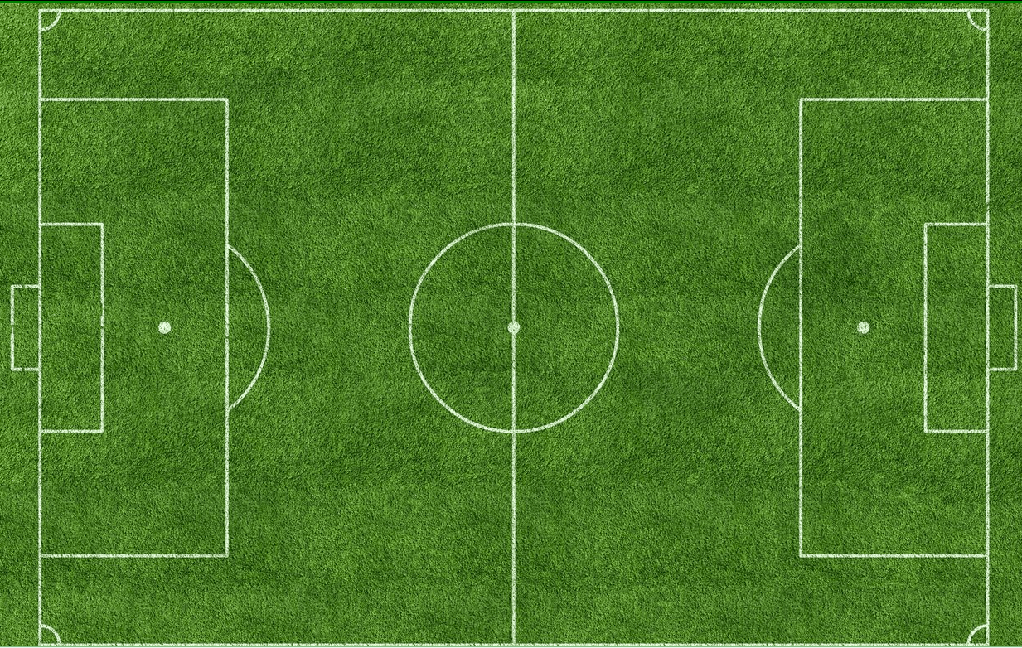
Sports Game Data
Game:
a set of multiple trajectories
E.g., Soccer game
(trajectories of 22 players and 1 ball)
A sequence of frames, and each frame contains multiple sampled locations
Play:
a portion of game that starts from the $i^{th}$ frame to the $j^{th}$ frame

Slide 3
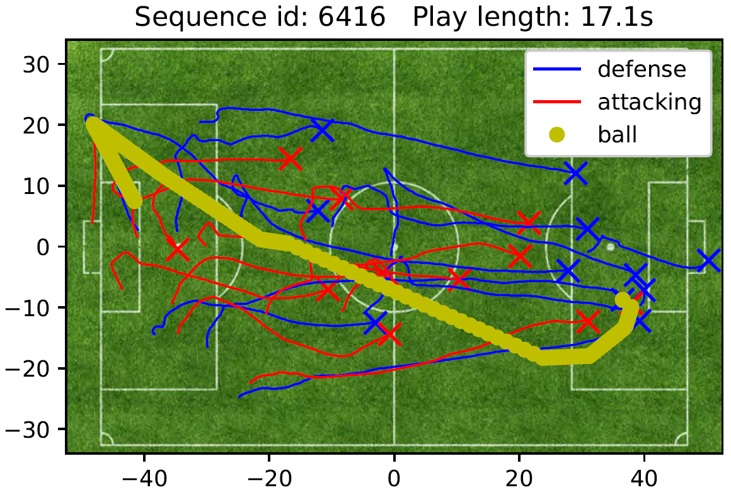
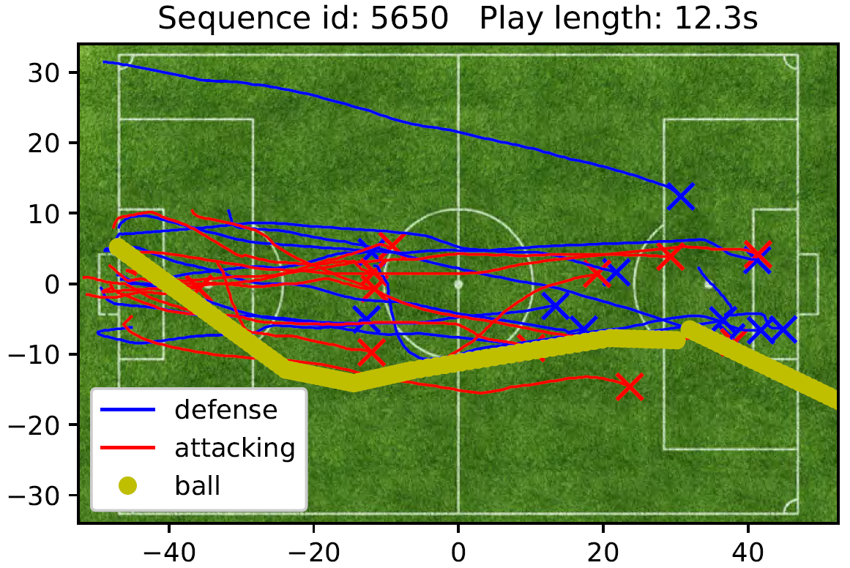
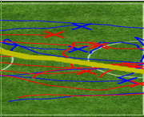
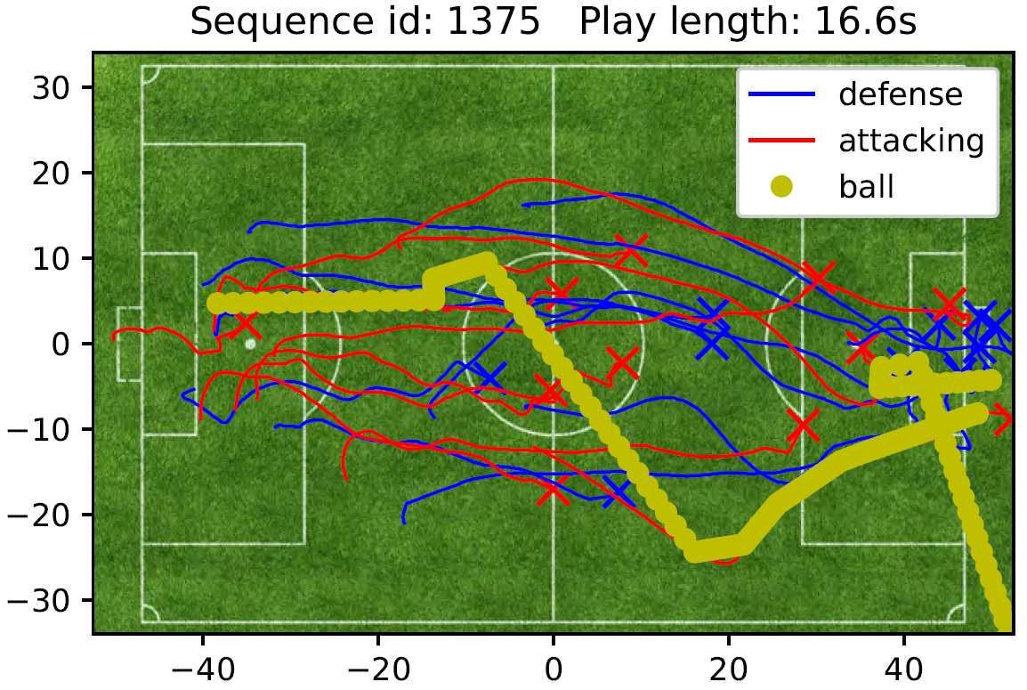
Similar Sports Play Retrieval (SimPlay)
A Database of Games
SimPlay Problem:
Find a play (the portion of a game) that is the most similar to the query play
Game 1
Game 2
… …
… …
Query play
Applications:
Recommend similar plays to sports fans
Game N

Slide 4
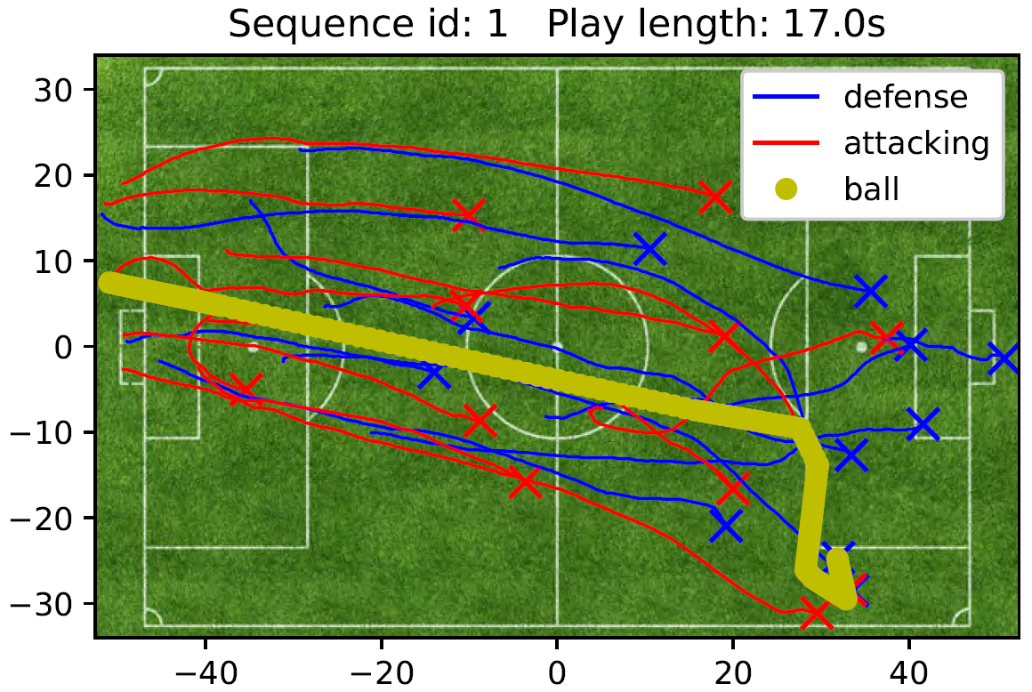
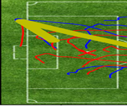
Existing Studies for the SimPlay Problem
Materialized as many data plays, whose duration fall in a range, e.g., from 1s to 3s
A Database
of Games
1s
2s
3s
… …
Query play
… …
Effectiveness Issue:
Small range duration
… …
… …
… …
… …
Efficiency Issue:
Large range duration
… …
[1] Sha et al. Chalkboarding: A new spatiotemporal query paradigm for sports play retrieval, IUI 2016

Slide 5
Three Challenges
How to measure the similarity between two plays?
Challenge-1 (similarity measure)
How to efficiently find a similar play to a query play within a game?
Challenge-2 (search within a game)
Challenge-3 (search within a database)
How to efficiently find a similar play within a database of many games?

Slide 6
Challenge-1 (similarity measure - play2vec)
Representation learning
(play2vec)
Efficiency advantage:
Linear time
R^{d}
Euclidean distance
[2] Wang et al. Effective and efficient sports play retrieval with deep representation learning, KDD 2019

Slide 7
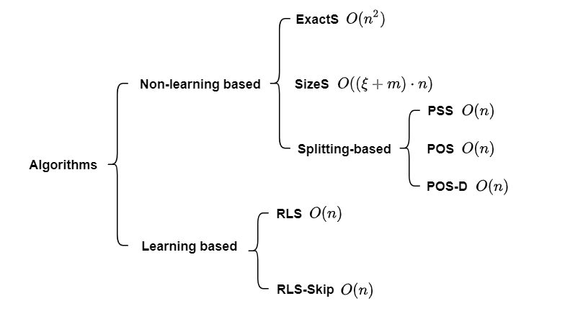
Challenge-2 (search within a game)
Linear time (play2vec)

Slide 8
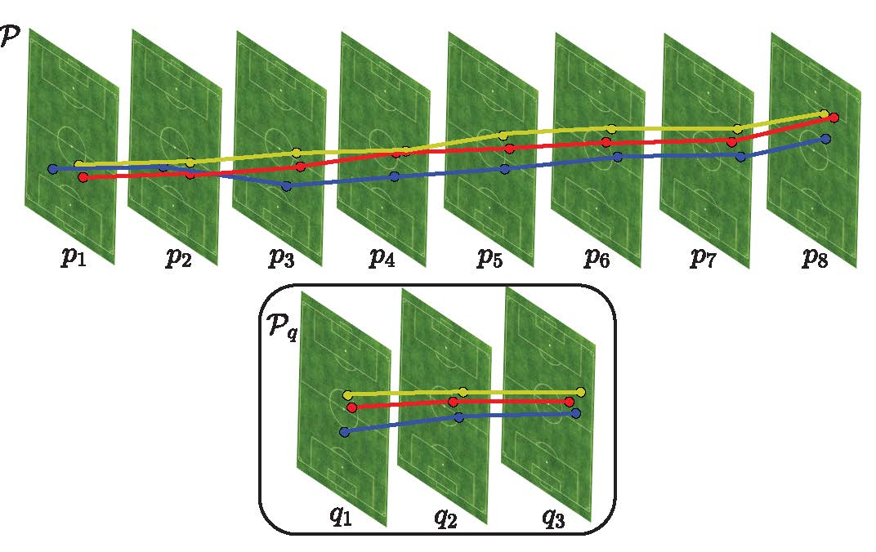
Challenge-2 (search within a game – RLS-Skip)
Idea: splitting a game into several plays and returning the most similar one.
Split at current point pi, it updates the splitting index to i+1
DQN
Skip next
point
Point
State
(best, prefix)
Action
Splitting
index
BEST
How to split (MDP):
State: S = (sim_best, sim_prefix)
Action: Split, No-split, Skip
Transition: from S to S’
Reward: S’.sim_best - S.sim_best
p1
(Ø,P[1,1])
Split
2
P[1,1]
p2
(P[1,1],P[2,2])
Skip
2
P[2,2]
P3
(skip)
-
-
-
-
p4
(P[2,2],P[2,4])
Split
5
P[2,4]
p5
(P[2,4],P[5,5])
Skip
5
P[5,5]
P6
(skip)
-
-
-
-
p7
(P[5,5],P[5,7])
Split
8
P[5,7]
p8
(P[5,7],P[8,8])
No-split
8
P[5,7]
Output: BEST=P[5,7]

Slide 9
Challenge-3 (search within a database - ScoreSearch)
Naive: search the most similar play (e.g., using RLS-Skip) from each game, and return the most similar play from a database
Idea: take the RLS-Skip as a metric, and learn its similarity score via deep metric learning
Costly
ScoreSearch (Triplet Network)
$$v_{+}$$
$$P_{+}$$
$$Net(∙)$$
$$W$$
$$v_{q}$$
Embedding Layer
(play2vec)
$$P_{q}$$
$$Net(∙)$$
Triplet Loss
$$W$$
$$v_{−}$$
$$P_{−}$$
$$Net(∙)$$
$$RLS−Skip\left(P_{q},P_{+}\right)>RLS−Skip(P_{q},P_{−})$$
Database

Slide 10
Challenge-3 (search within a database - ScoreSearch)
A Database
of Games
Build index for the vectors (e.g., K-D Tree)
Phase I
$$O(m+α(N))$$
Game 1
ScoreSearch
ScoreSearch
R^{d}
Game 2
… …
… …
Query play
Game N-1
Game N
retrieve a small fraction $r$ of games with the highest scores
(e.g., Top 10%)

Slide 11
Challenge-3 (search within a database - ScoreSearch)
Retrieved Games
Phase II
$$O(r·N·β(n))$$
Game 1
Game 2
… …
… …
Query play
RLS-Skip
Game $r$N

Slide 12
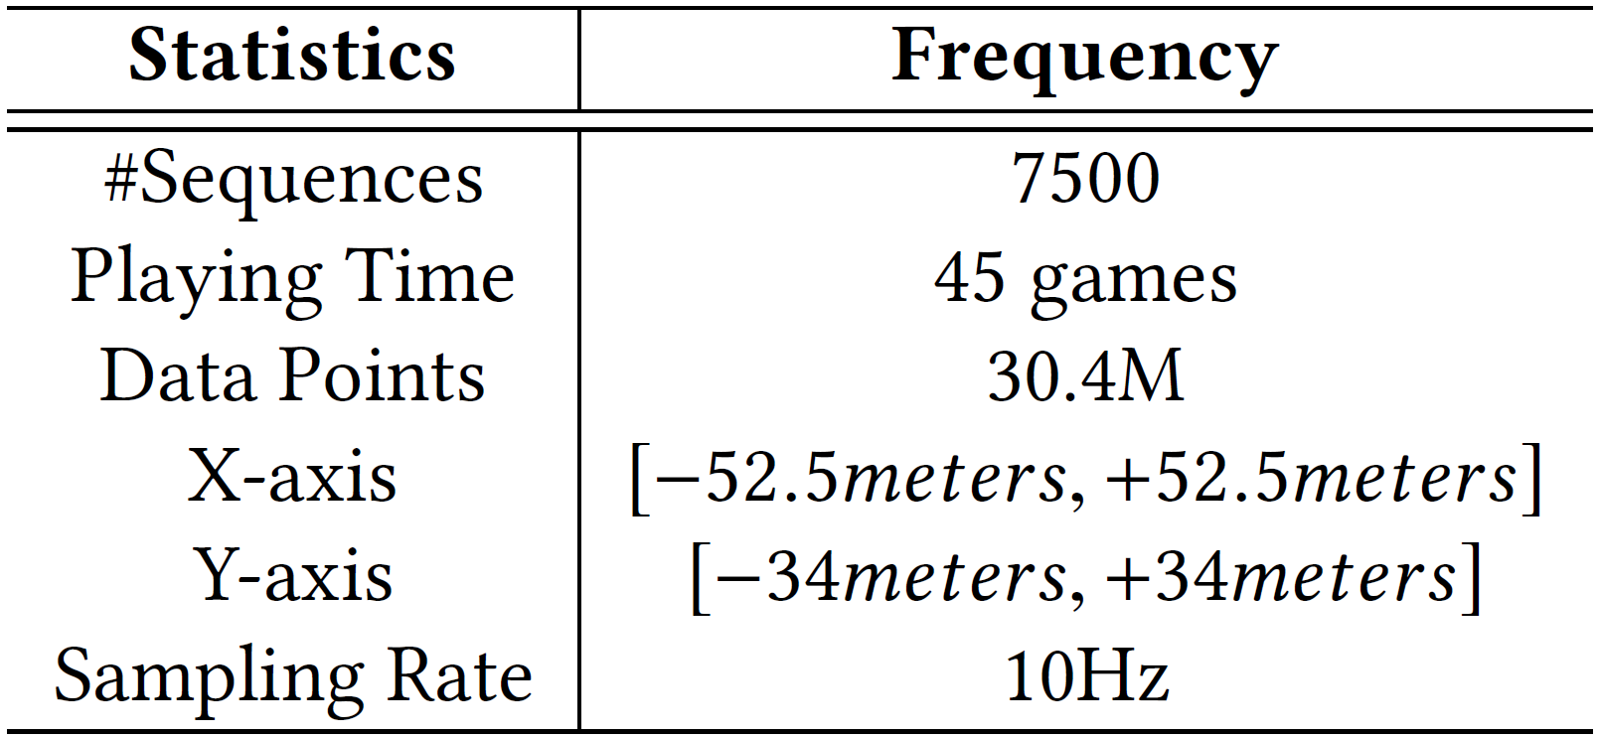
Experiment Set-up
Experiments | Performance metrics
Similarity measure | In our previous [2]
Search within a game | Approximate ratio Mean/Relative rank
Search within a database | Relative rank

Slide 13
Effectiveness and Efficiency Results (Search within a game)

Slide 14
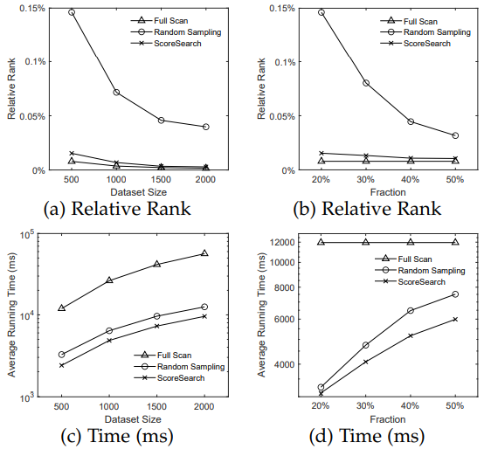
Effectiveness and Efficiency Results (Search with in a database)

Slide 15
Conclusion
Problem
the SimPlay Problem
Algorithm
Similarity Measure (play2vec)
Search within a Game (RLS-Skip)
Search within a Database (ScoreSearch)
Experiments
Effectiveness
Efficiency

Slide 16
Q & A
THANKS FOR WATCHING

